Slide 1
CS 321 PROJECT OREGANO’S
Group 2 – Section 6F9
(Leader) Aseel Alqahatani | 2200003677
Ghaida Alshammari | 2200005622
Fay Alsadlan | 2200005122
Thuraya Alzubaidi | 22000006254
Sara Alzahrani | 2200005923
Dana Alsharari | 2200004812
Layan Faisal Alanazi | 2200003089

Slide 2

ITALIAN RESTAURANT APPLICATION
Description: Our Restaurant system will include an Italian cuisine menu. The restaurant application will provide various services. It will allow the User to browse and select from the menu items from various categories and make new orders. The mangers will have the authority to manage the staff. Also, the employees to receive and control the orders.

Slide 3
System Users:
01
02
Managers:
will be able to add new employee, search for
specific employee, and delete employees.
Employees:
will be able to add, delete and update orders.

Slide 4
Class Hierarchy:
We have 3 super classes & 7 Subclasses
UML is shown in the next slide..

Slide 5
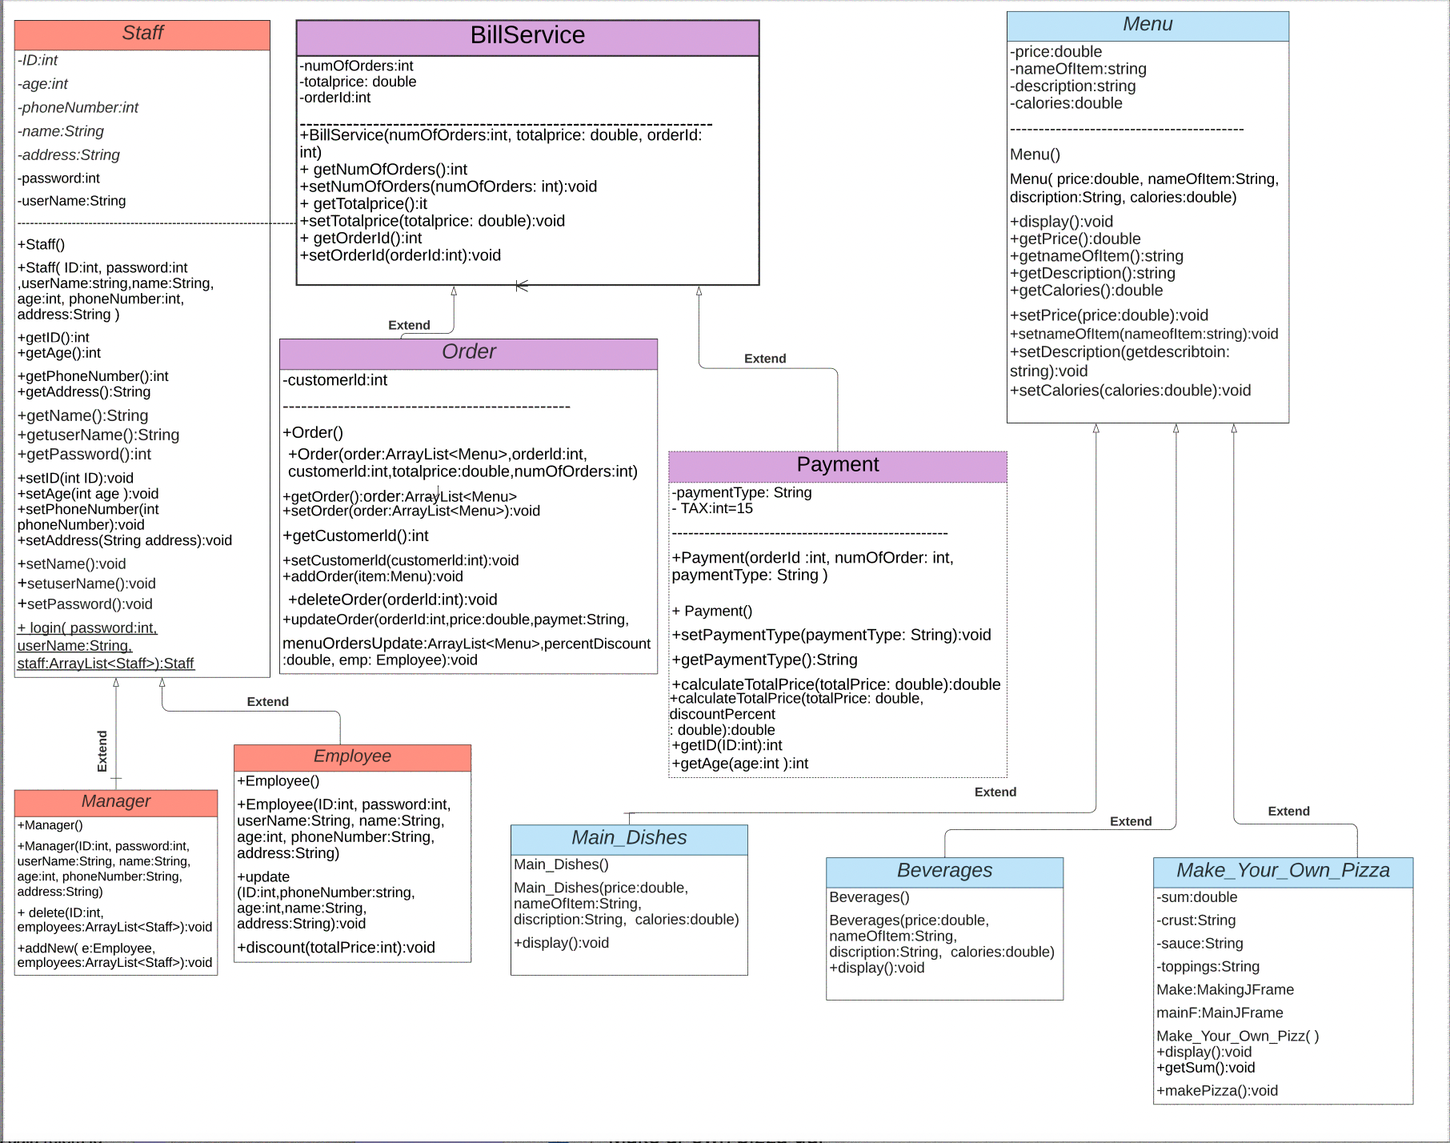

Slide 6
Database Design

Slide 7
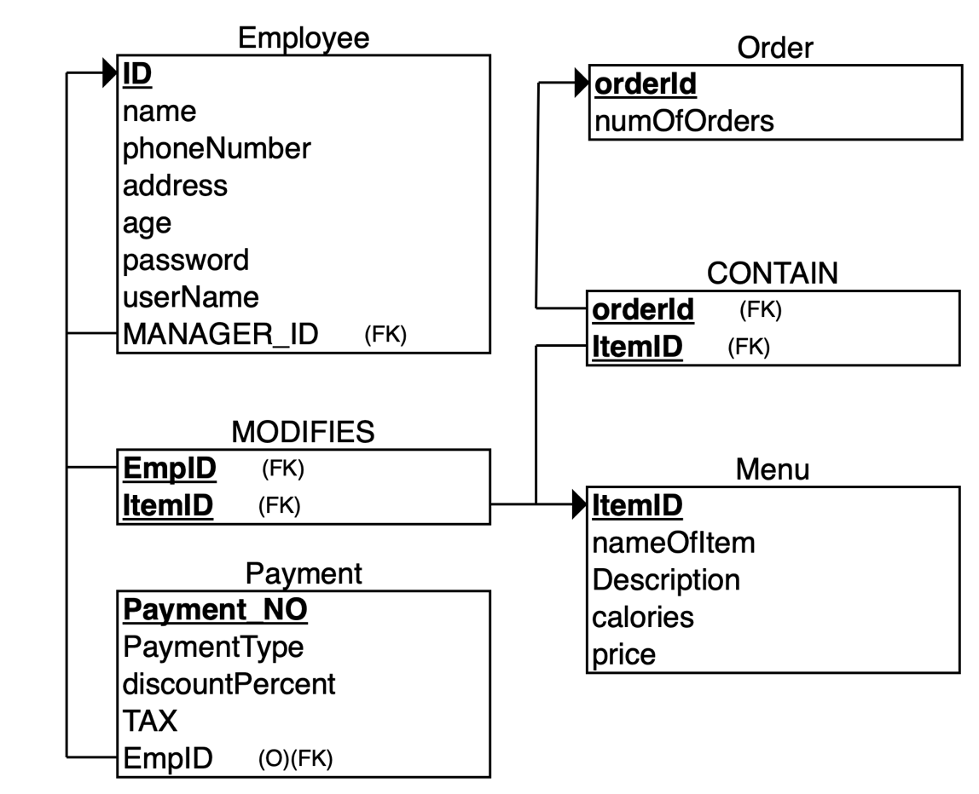
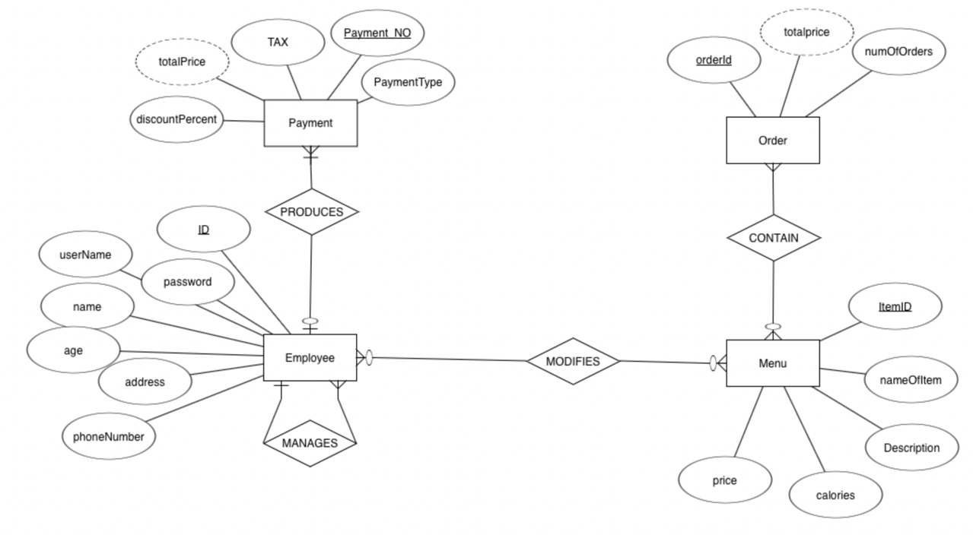
ER diagram VS. Schema
ER diagram
We have 6 tables in the database
Schema

Slide 8
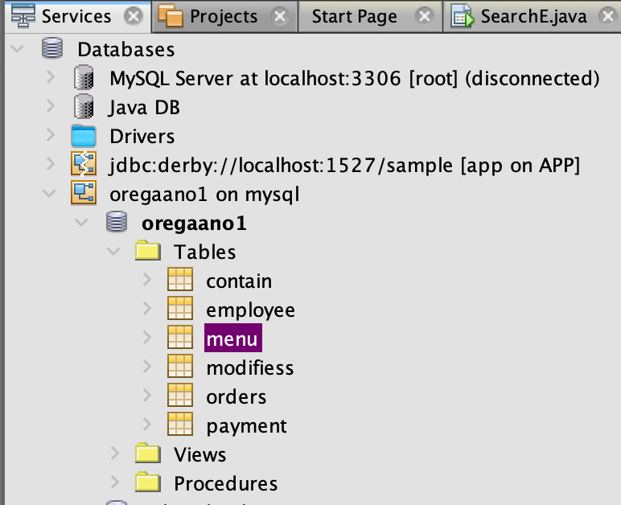
Connecting java code to the database

Slide 9
Difficulties & how problems were solved:

Slide 10
Difficulties
Time
It was difficult for us to find a suitable time for all the group
members to join in, especially that it was difficult to conduct a
physical meeting during the vacation.
Solution: We used virtual methods instead, such as WhatsApp &
Zoom to help us maintain the work progress.
SQL database
We faced some difficulties when transferring databases between
devices & while trying to connect the database as well.
Solution: We used zoom remote control so that each student makes
the adjustments she needs to do, and we wrote the sql code again in
the same device where we applied the connection, and it worked.

Slide 11
Application Interface

Slide 12
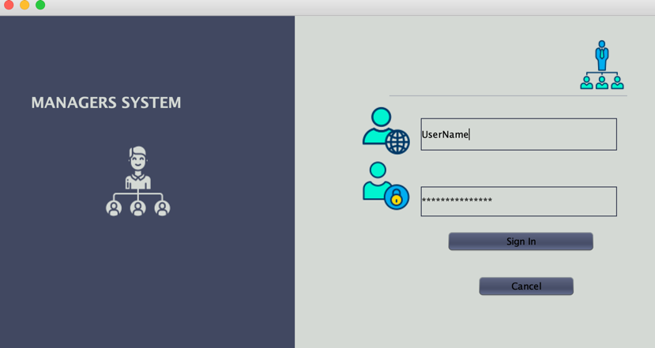
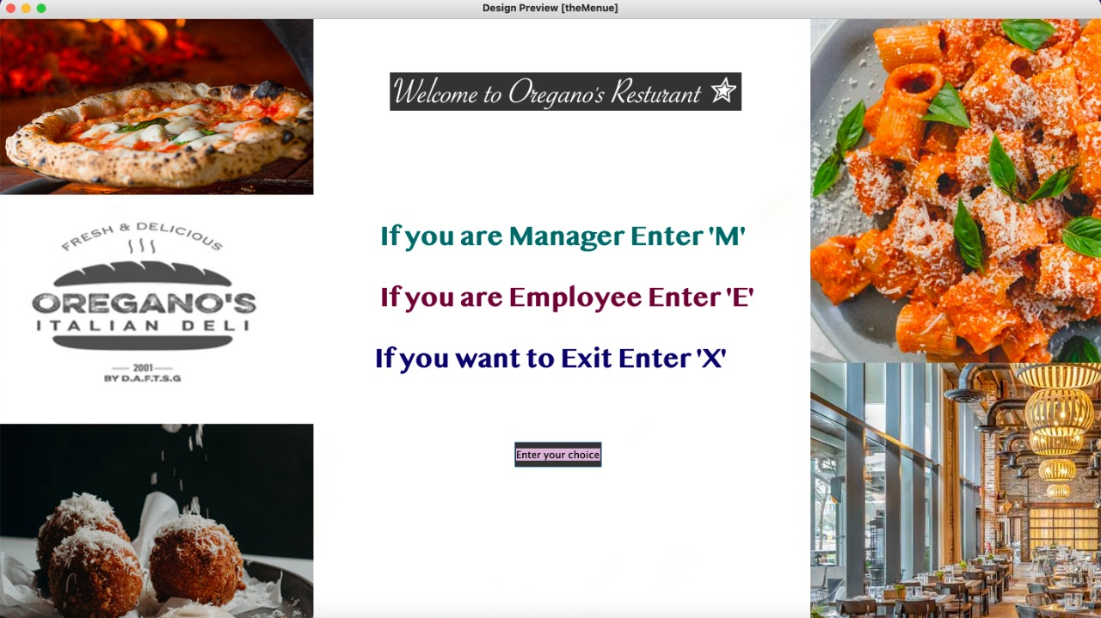
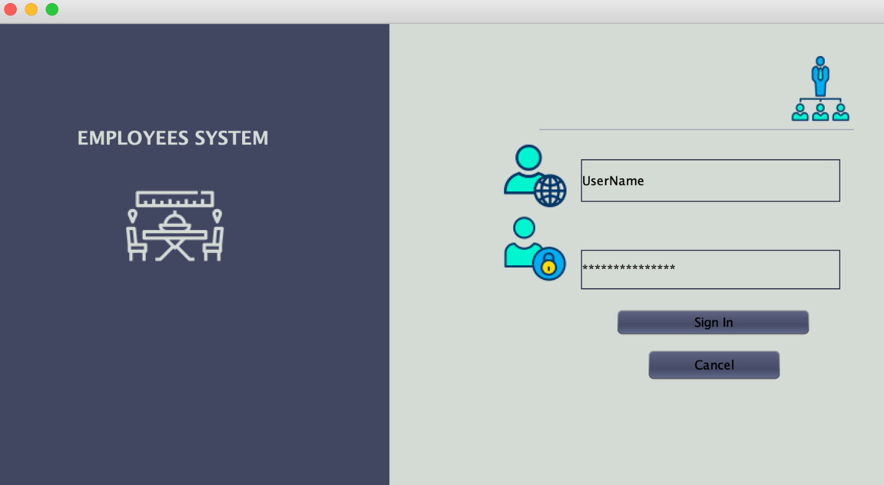
When the user Enters M:
Home Page
When the user Enters E:

Slide 13
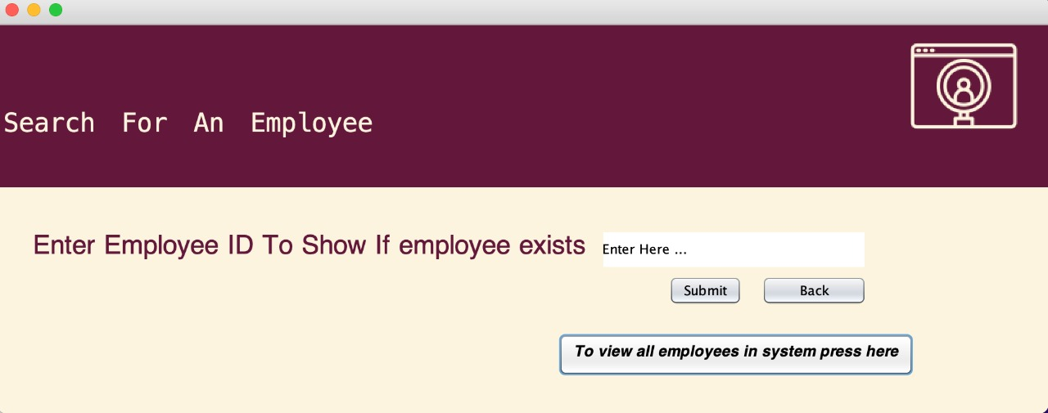
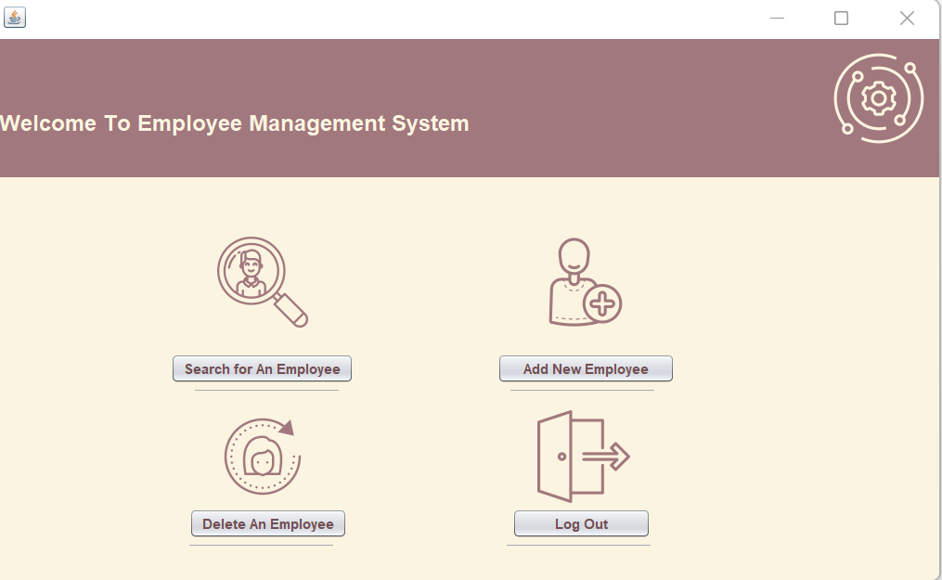
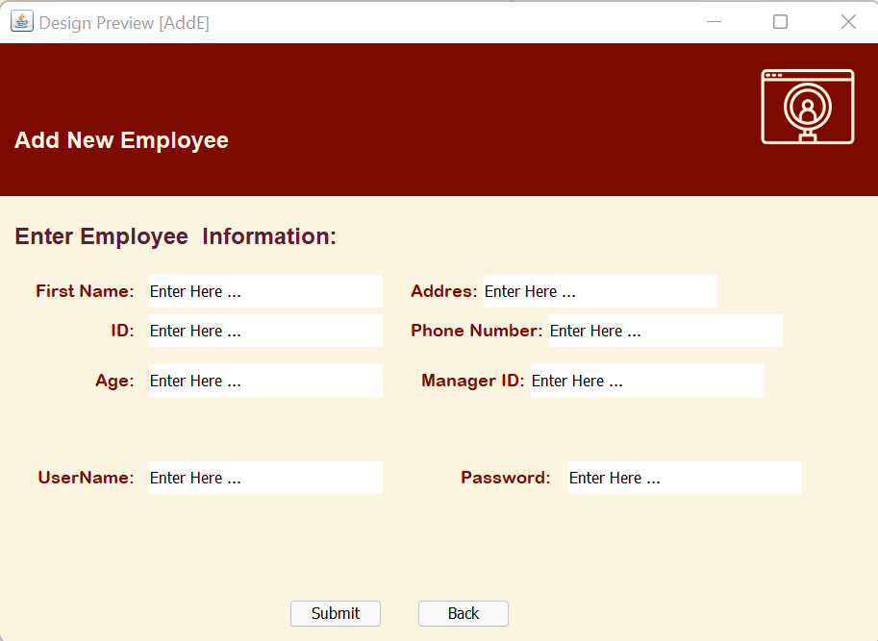
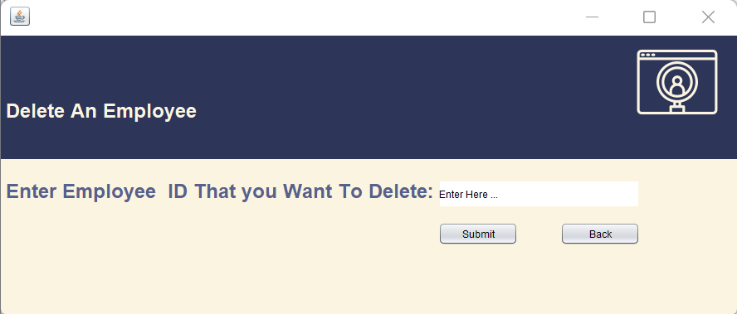
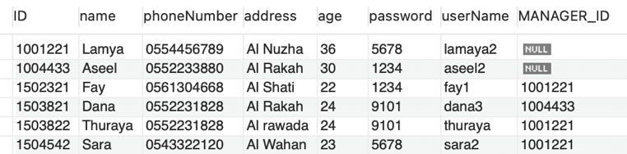
After entering Managers System:
The “Employee”table in the database will be affected:

Slide 14
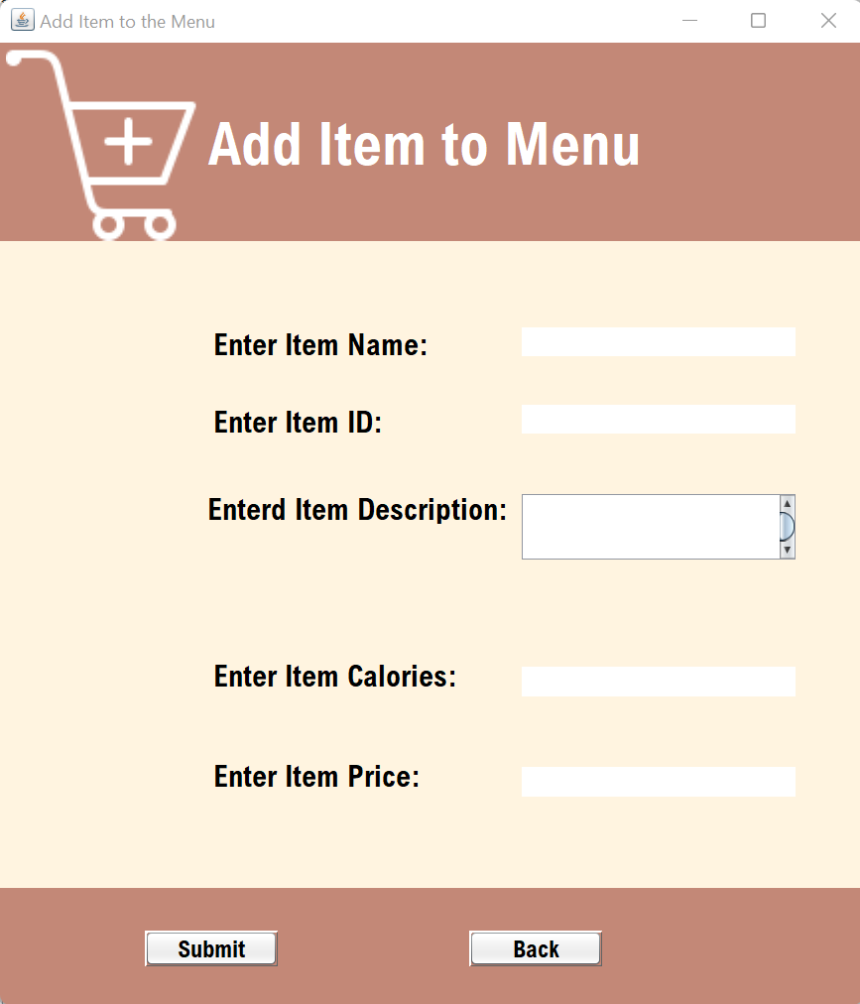
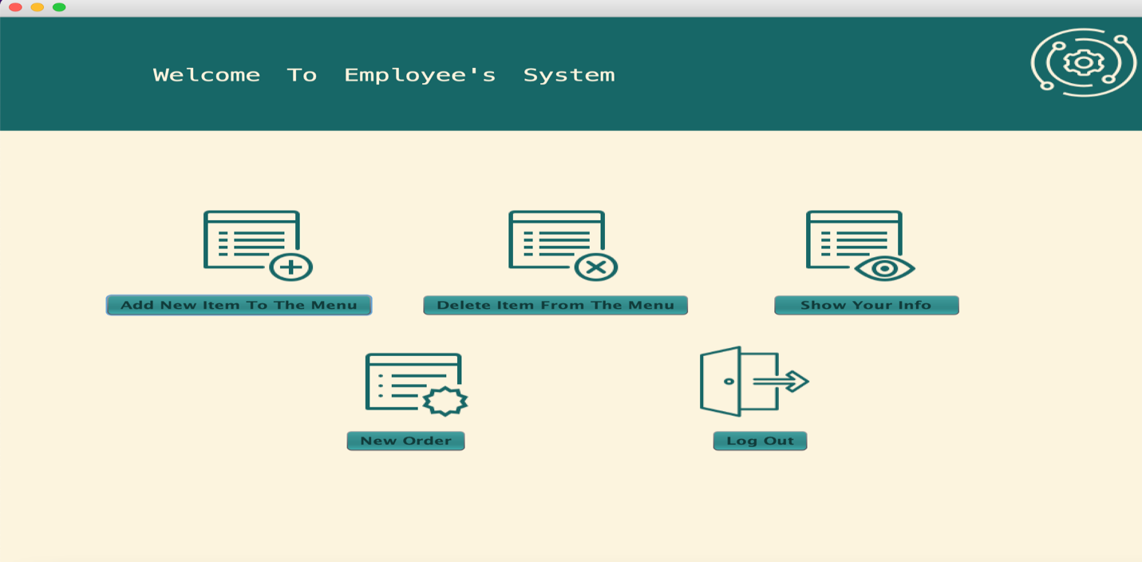
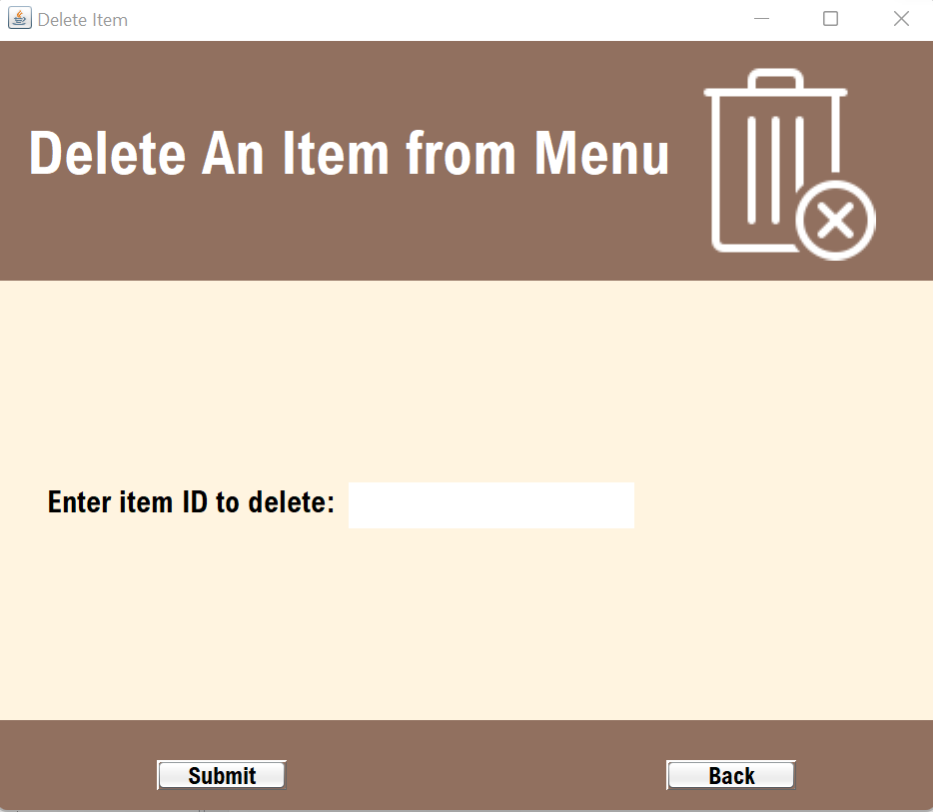
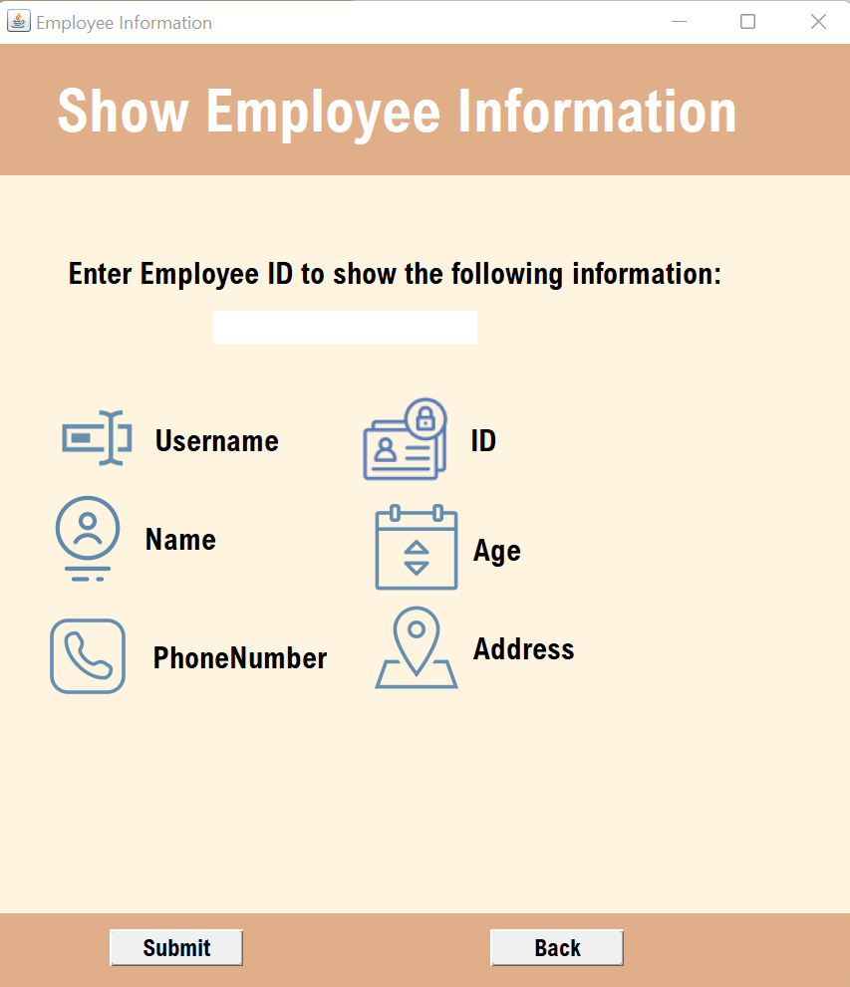
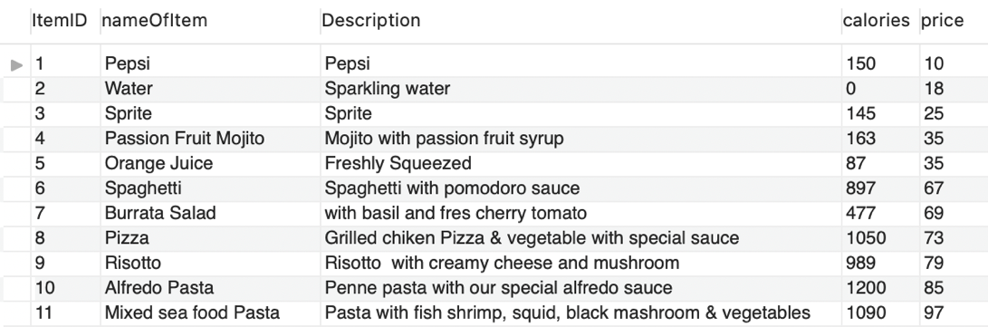
After entering Employees System:
The “Menu”table in the database will be affected:

Slide 15
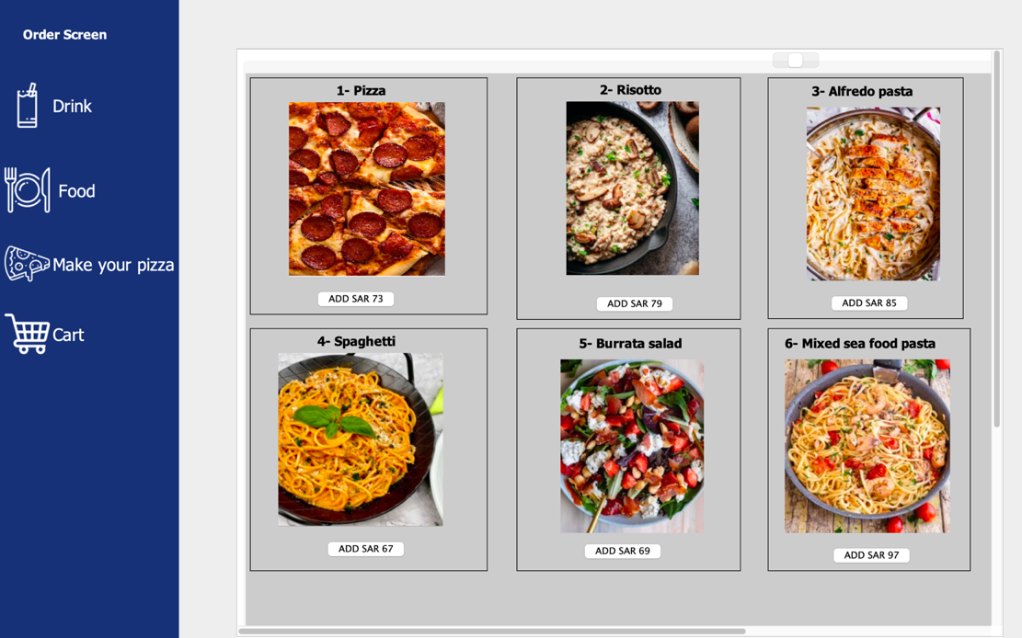
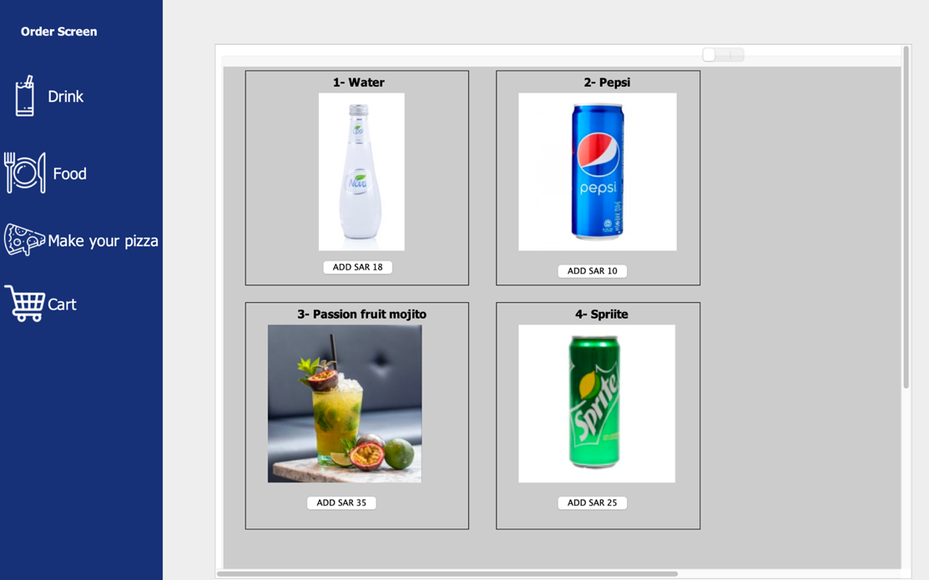
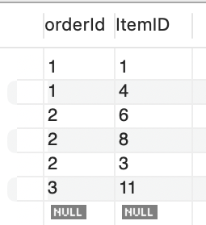
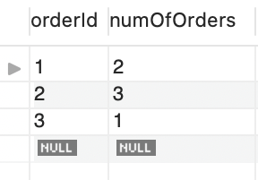
After selecting ”New Order”from Employees System:
The “Orders”& “Contain” table in the database will be affected:

Slide 16
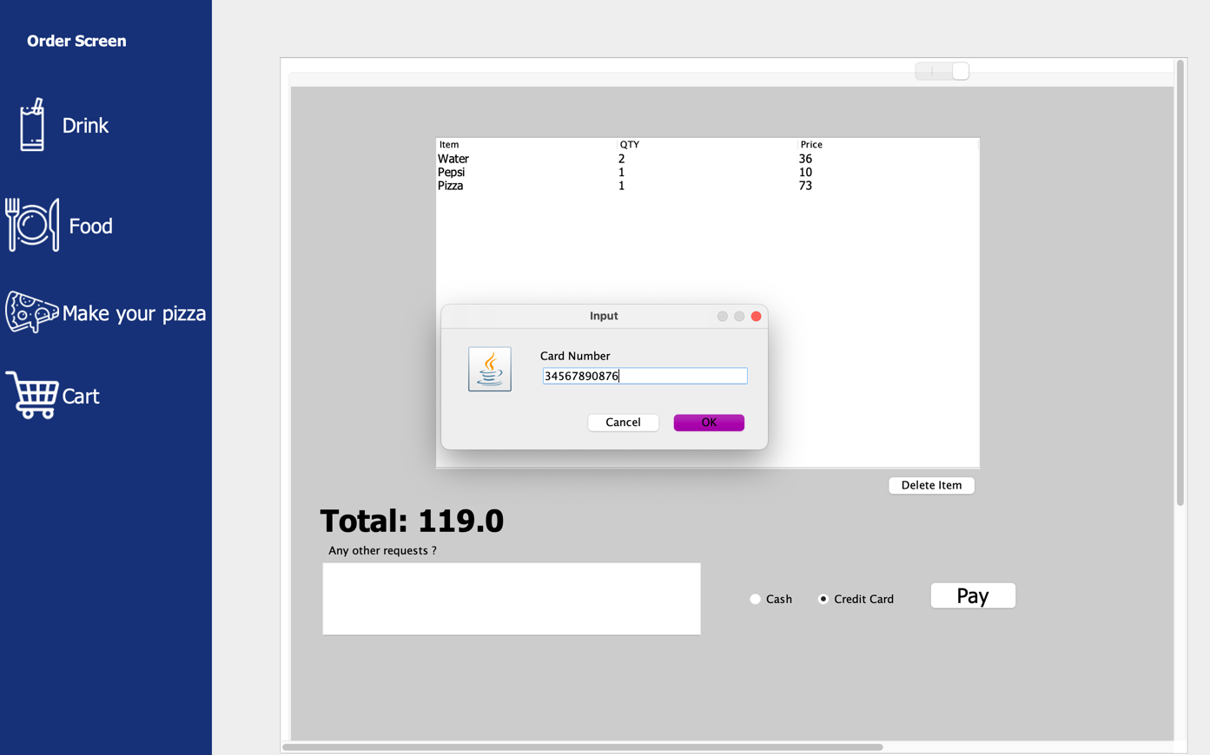
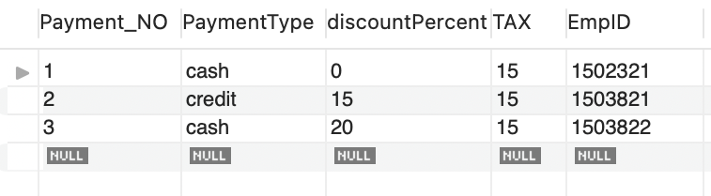
After selecting ”Cart”:
After clicking choosing the payment method & clicking pay button, The changes will be reflected in“Payment”table :

Slide 17
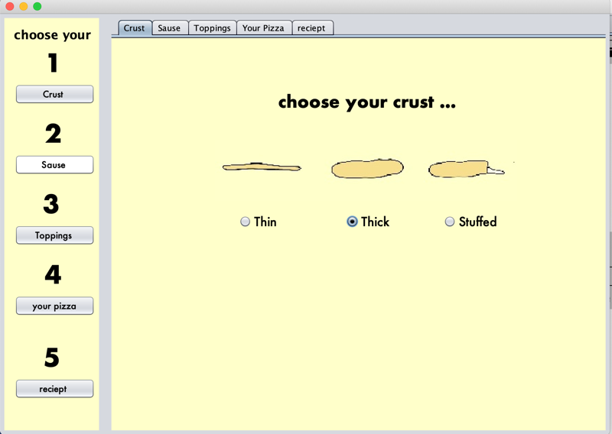
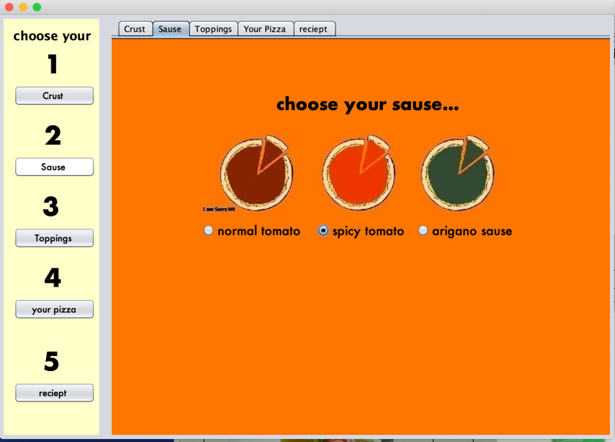
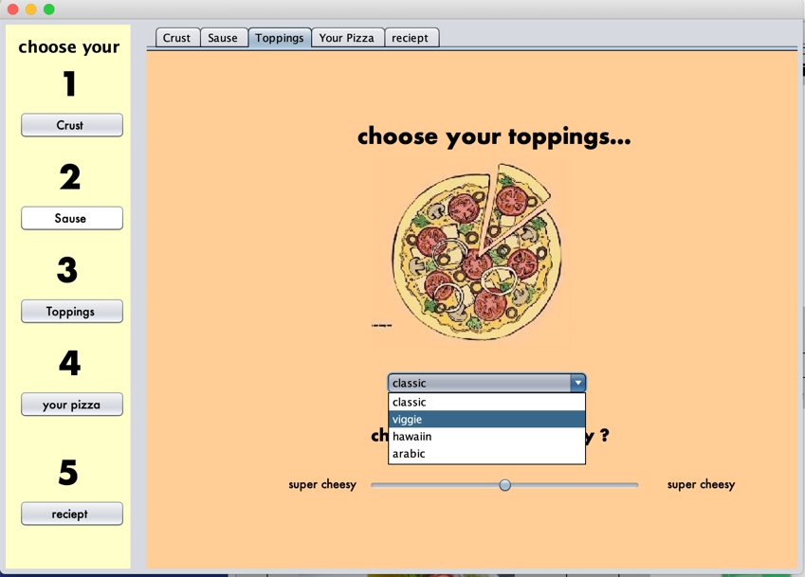
After clicking “make your pizza”:

Slide 18
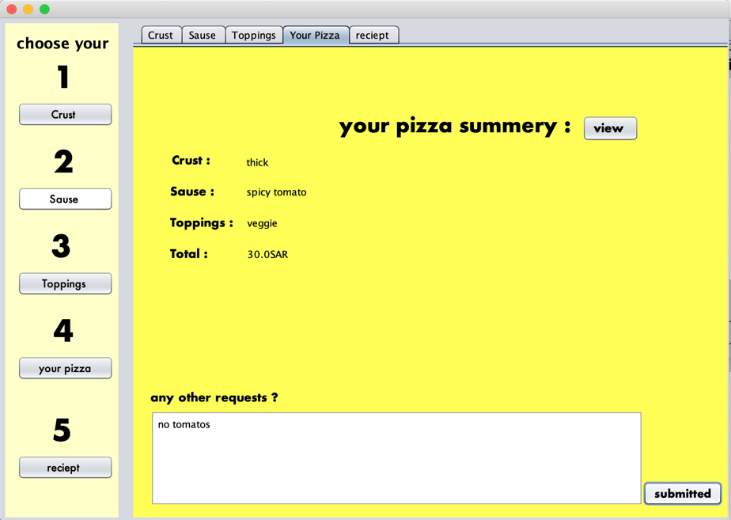
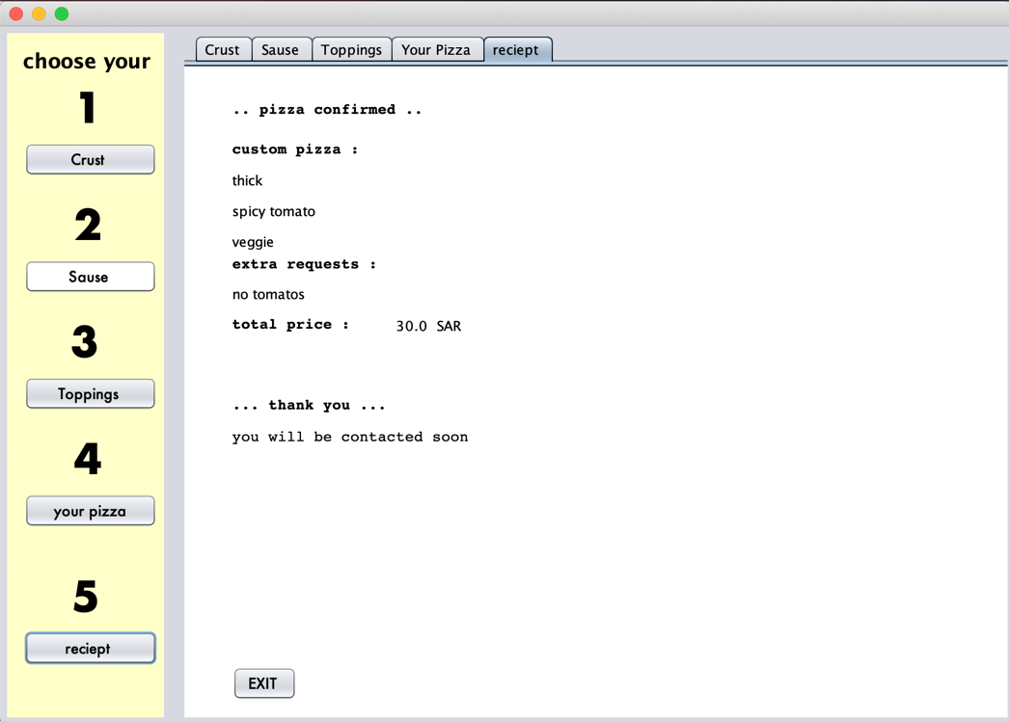
To view your pizza summary and submit other requests, and view the receipt:
After clicking Exit button it will return to order screen

Slide 19
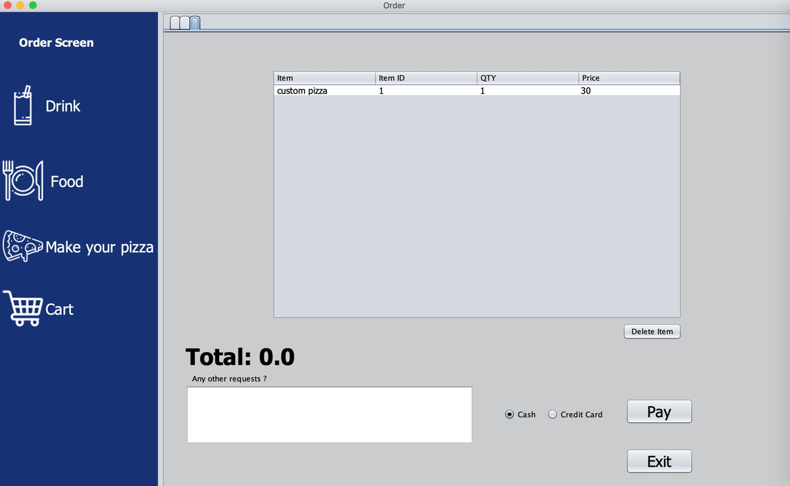
After selecting ”Cart”:
After clicking choosing the payment method & clicking pay button, The changes will be reflected in“Payment”table :

Slide 20
THANK YOU!
(Leader) Aseel Alqahatani | 2200003677
Ghaida Alshammari | 2200005622
Fay Alsadlan | 2200005122
Thuraya Alzubaidi | 22000006254
Sara Alzahrani | 2200005923
Dana Alsharari | 2200004812
Layan Faisal Alanazi | 2200003089

